Slide 1
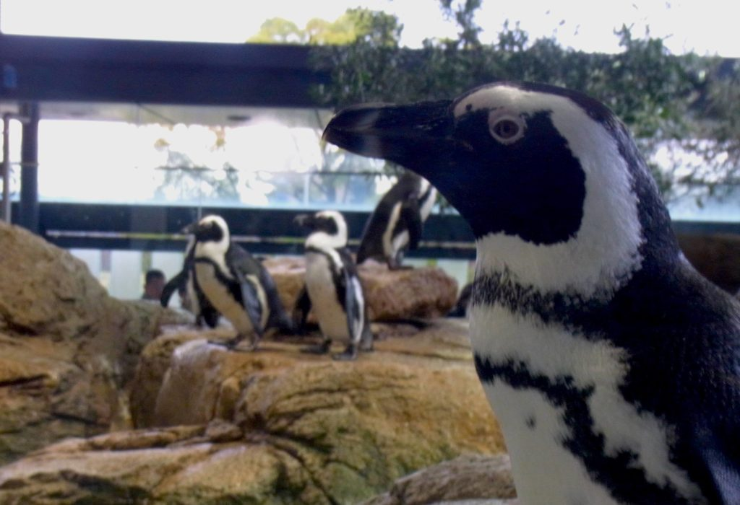
Penguins of Kyoto
Ciardi Guido Martinelli Giuseppe Sirgiovanni Massimiliano Tosi Federica

Slide 2


Dataset Description
The dataset is based on the 2020 version of the flowchart of penguin relationships maintained by Kyoto Aquarium.
The dataset contains 59 named penguins with their gender and several types of relationships between them:
Couples;
Exes;
Family;
(It's) complicated;
Friends;
Enemies;
Notes:
G

Slide 3
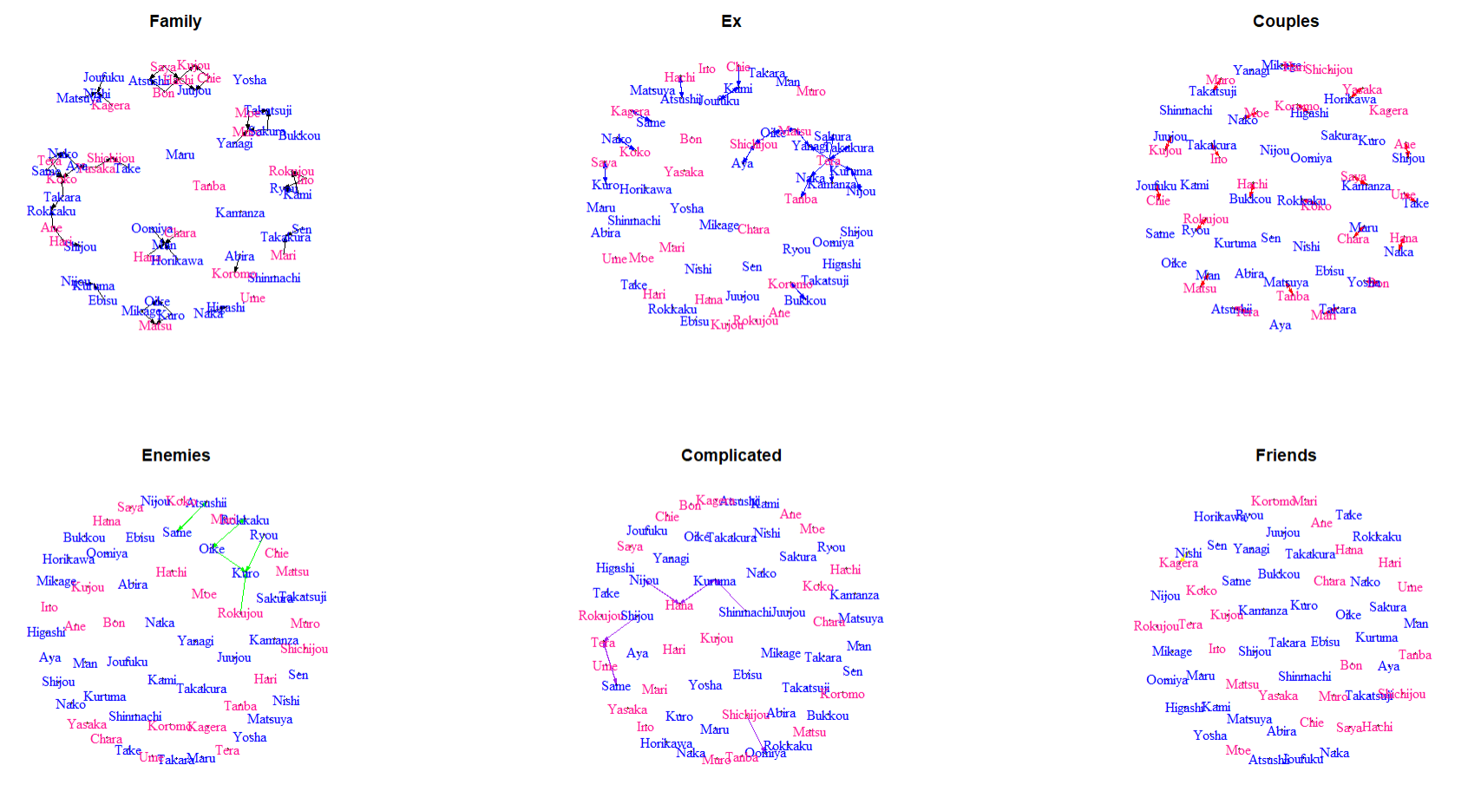
Notes:
G Sei diversi grafi che rappresentano sei diversi tipi di relazioni. Per effettuare le nostre analisi sono stati scelti I tre dataset meno sparsi (I primi 3)

Slide 4
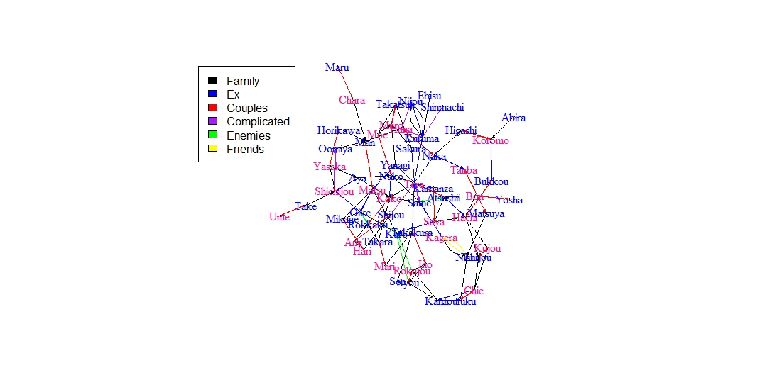

Complete graph
fusion <- rbind(as_data_frame(graph_enemies), as_data_frame(graph_complicated), as_data_frame(graph_family), as_data_frame(graph_ex), as_data_frame(graph_couples), as_data_frame(graph_friends))
Notes:
G
Multigrafo ottenuto tramite la fusione di tutte le diverse relazioni viste in precedenza (usato per le analisi)

Slide 5
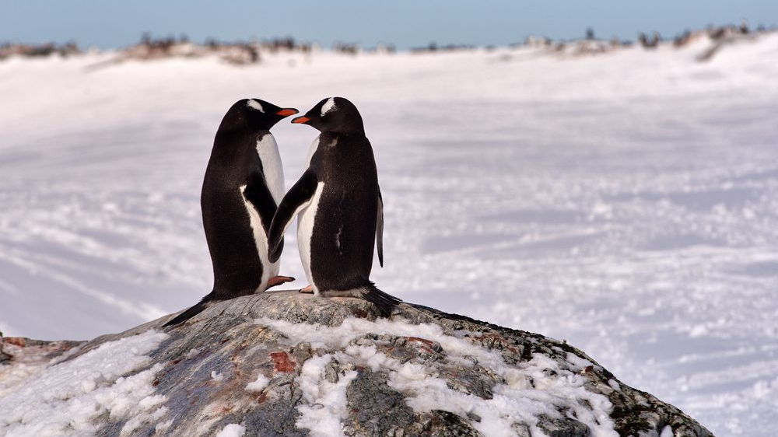
Network statistics
Notes:
F

Slide 6



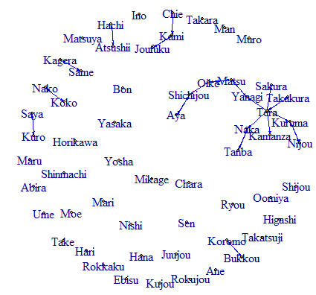
Density is a measure on graphs that allows us to compare our graph to the full configuration.
The selected graphs, as can be seen from the table, are all low-density.
Graphically, in fact, we can see many isolated nodes, except in the case of the merged graph, and rather small connected components.
 | DENSITY
COUPLES | 1.2%
EXES | 0.9%
FAMILY | 1.4%
COMPLETE | 4%
Exes graph
Notes:
F

Slide 7
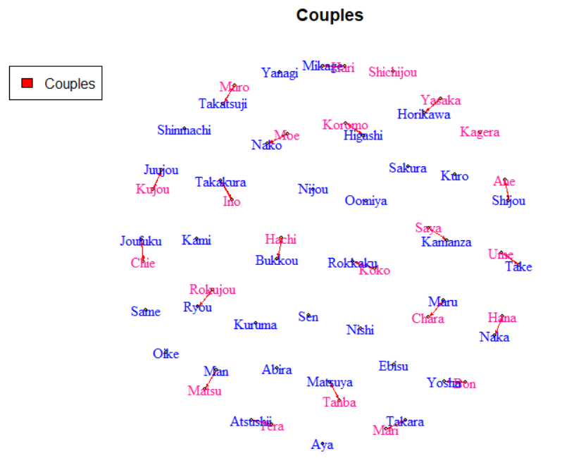
Reciprocity indicates the number of bidirectional relationships in the graph compared to the total number of relationships present.
Special cases are:
the couple graph, given that every relationship is bidirectional, indicates that penguins have only consensual relationships;
the family graph, in which the relationships represented are of the child-parent type and therefore, by definition, cannot be bidirectional.
 | RECIPROCITY
COUPLES | 100%
EXES | 77.42%
FAMILY | 0%
COMPLETE | 57.55%
Couples graph
Notes:
G

Slide 8

Transitivity is a measure on graphs that is closely related to the concept of triangles.
In fact, it indicates, with respect to the number of triples present in the graph, how many of these are triangles or not (i.e. all three nodes are connected directly).
Couples graph: transitivity is NaN since there are no
triples in the graph, as there are only
monogamous relations.
 | TRANSITIVITY
COUPLES | Nan
EXES | 0%
FAMILY | 0%
COMPLETE | 21.71%
Family graph: since the connected components of the
graph have a tree structure, there can
be no triangles.
Ex graph: value zero in the case of the indicates
that there are no triangles, but it is not
due to any basic feature of the graph.
Notes:
M

Slide 9
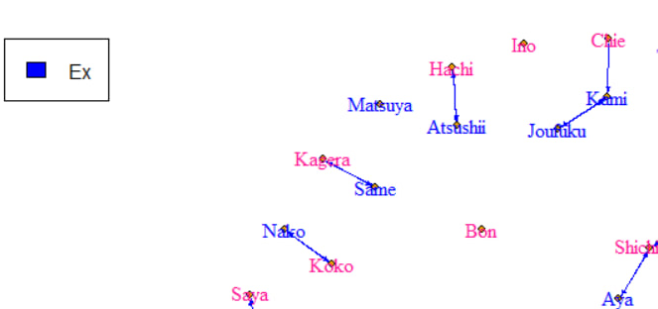
Assortativity is a measure that allows to observe the level of homophily within the graph, and its value is included in the interval [-1, 1].
1 indicates perfect homophily;
-1 indicates perfect heterophily.
For example, the couples graph has perfect heterophily since there are no current same-sex relationships among penguins.
On the contrary, the graph of the exes has a very low assortativity level, but not equal to -1, since there is a homosexual relationship between penguins, which however did not go through.
 | ASSORTATIVITY
COUPLES | -1
EXES | -0.7659417
FAMILY | -0.008883013
COMPLETE | -0.516669
Notes:
P

Slide 10
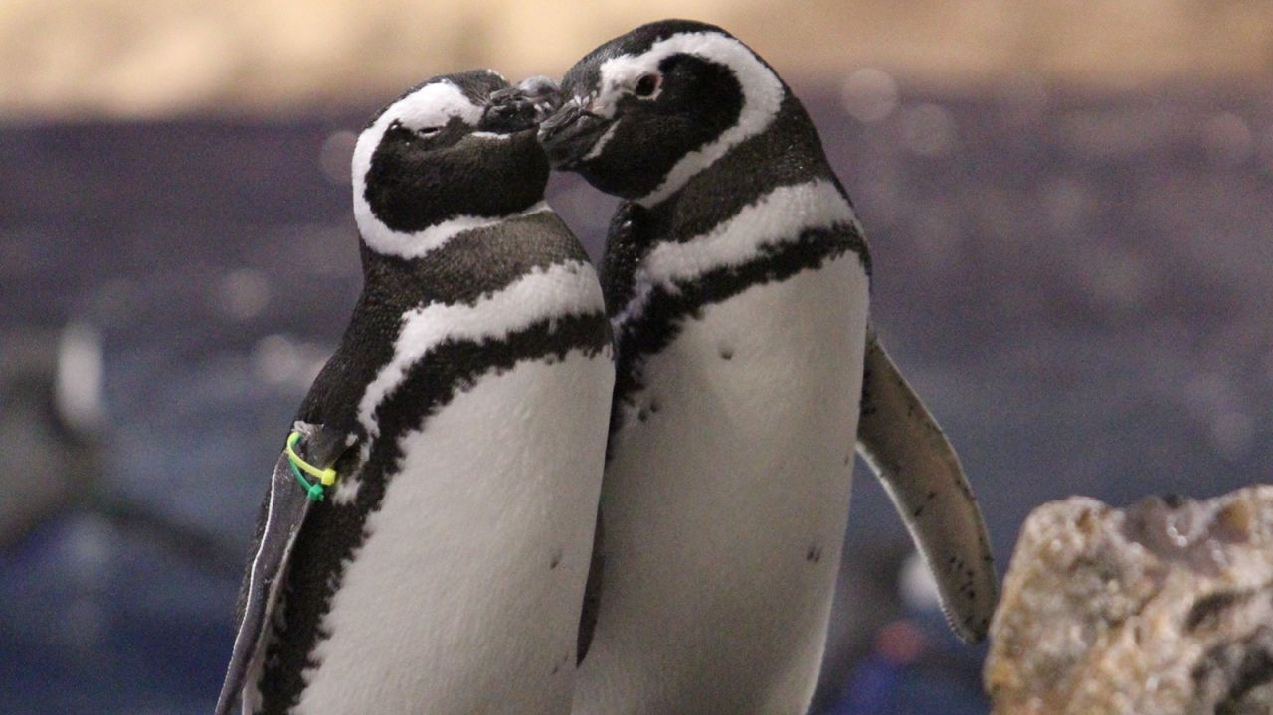
Nodal statistics
Notes:
F

Slide 11

Degree centrality: a node is central if it's connected to many other nodes. The higher the degree, the more central the node is.
Family: there are child-parent relationships represented, so the maximum out-degree must necessarily be 2; The highest in-degree is of Man and Koko
Couples: the maximum value found is 1 because penguins only have monogamous relationships;
Exes: the maximum value of the out-degree, obtained from the node corresponding to Tera. As confirmed by metadata, she is the penguin who has rejected the most suitors;
Complete: Tera remains the node with the most out- relationships, probably due to the exes graph. The nodes with the highest in-degree are Kuruma and Koko.
 | MAX DEGREE CENTRALITY
 | IN | OUT
COUPLES | 1 | 1
EXES | 2 | 6
FAMILY | 4 | 2
COMPLETE | 6 | 10
Notes:
F

Slide 12

Notes:
F

Slide 13

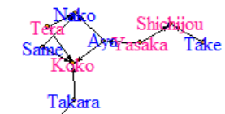
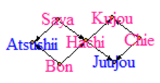
Closeness centrality
Closeness centrality indicates how close a node is to all other nodes in the network.
Tera___ in: Nan
Tera___ out:
1/(TN+TK) = 1/2 = 0.5000000
Kujou__ in:
1/(SHK + BHK + HK + CK) = 1/6 = 0.1666667
Kujou__ out: Nan
There are many nodes with maximum value of both in-closeness and out-closeness
Notes:
G

Slide 14
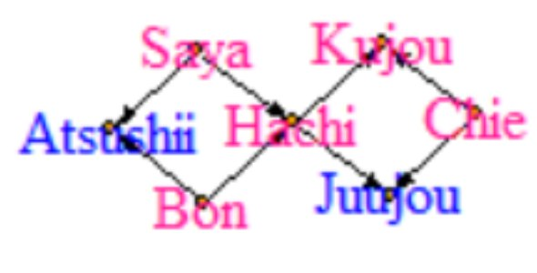
Betweenness centrality is a measure of centrality in a graph based on shortest paths.
The betweenness centrality for each vertex is the number of these shortest paths that pass through the vertex.
 | Family | Ex | Couples | Complete
Min | 0.000e+00 | 0.000000 | 0 | 0.000000
1st Qu | 0.000e+00 | 0.000000 | 0 | 0.002483
Median | 0.000e+00 | 0.000000 | 0 | 0.011494
Mean | 3.589e-05 | 0.000241 | 0 | 0.040722
3rd Qu | 0.000e+00 | 0.000000 | 0 | 0.056108
Max | 1.210e-03 | 0.003327 | 0 | 0.245034
In Couples graph, the maximum betweennes value is always 0, since there are only paths of length one, therefore no node can be crossed by the path between two other nodes.
Tera is the node with the highest betweennes both in Exes and Complete graph, while Hachi is the one with the highest value for the Family graph, in fact, it is located in the center of one of the two largest families.
Notes:
M

Slide 15
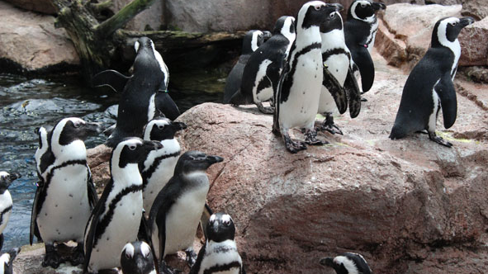
Eigenvector centrality measures a node’s importance while giving consideration to the importance of its neighbors.
​ | Family​ | Ex​ | Couples​ | Complete​
Min​ | ​0.00000 | ​0.00000 | ​0.00000 | ​0.003169
1st Qu​ | ​0.00000 | ​0.00000 | ​0.00000 | ​0.027638
Median​ | ​0.00000 | 0.00000​ | ​0.00000 | ​0.060688
Mean​ | ​0.04761 | ​0.05412 | ​0.04468 | ​0.092582
3rd Qu​ | ​0.00000 | ​0.00000 | ​0.04754 | ​0.124798
Max​ | ​0.51642 | ​0.54535 | ​0.31252 | ​0.460284
The 3rd quartile values are quite low just because there are no nodes much more central than others, that are quite sparse graphs.
The nodes with maximum eigvector centrality are: Koko for the Family graph, Tera in Exes, Mikage in couples and Nishi in the complete
Notes:
P

Slide 16

Graph models
Notes:
G

Slide 17
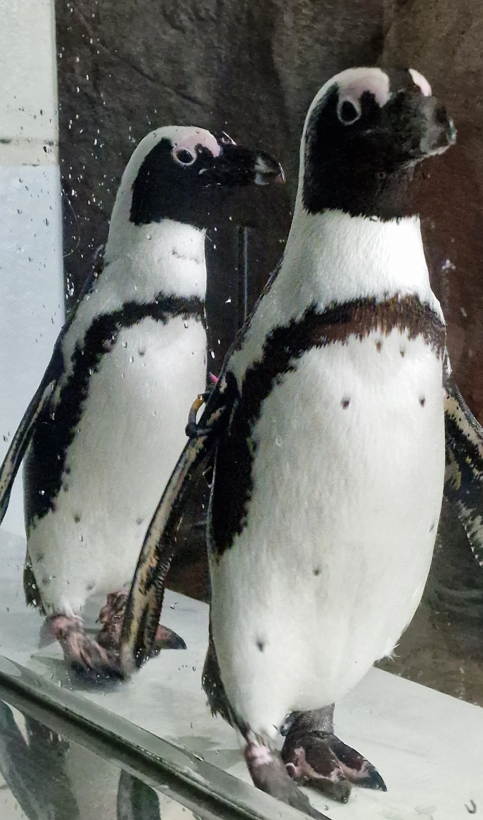
Basic models
It was decided to apply the models seen in class on the four selected graphs.
We started by applying the Homogeneous BRG (mod0: edges) and the NH-BRG (mod1: edges + sender + receiver).
Edges coefficient: negative and significant, less ties than expected by chance
Senders and receivers effect: in mod1 they are either -Inf or not significant.
Therefore for subsequent models it was decided not to include them.
 | Family |  | Ex |  | Couples |  | Complete
 | AIC | BIC | AIC | BIC | AIC | BIC | AIC | BIC
mod0 | 507 | 513 | 355 | 361 | 455 | 461 | 1152 | 1158
mod1 | 451 | 705 | 325 | 547 | 561 | 1013 | 1268 | 1954
Notes:
G

Slide 18
P1 model
Not considering the effect of senders and receivers, we simply apply the model with the parameter related to mutual relationships.
Family -> coefficient related to the factor is equal to -Inf, since there are no mutual relationships (child-parent relationships);
Ex -> coefficient relative to mutual is significant and positive, but in some cases the model fails to run (probably due to different seeds);
Couples -> the model fails to run (probably due to large number of isolated nodes);
Complete -> mutual coefficient is positive and significant.
​ | Family​ |  | Ex​ |  | Complete​
​ | AIC​ | BIC​ | AIC​ | BIC​ | AIC​ | BIC​
mod0​ | 507​ | 513​ | 355​ | 361​ | 1152 | 1158
mod3 | NaN | NaN | 248 | 260 | 960 | 973
mod3: edges + mutual (edges coefficient always significant and negative)
Notes:
F

Slide 19


Models with Nodal Attributes
The only attribute in our dataset is the Penguin Gender.
It is introduced within the models, as main and homophily effect, but in most of the models it is not significant.
mod4: edges + mutual + node_factor + node_match;
mod5: edges + mutual + node_match.
Only in the complete graph nodematch is negative and significant: same gender nodes are less connected than others.
For the couples graph, as coefficients we obtain values equal
to NaN and -Inf, because there are no homosexual relationships.
​ | Complete​
​ | AIC​ | BIC​
mod3 | 960.6 | 972.8
mod4 | 935.2 | 959.8
mod5 | 935 | 953.4
​ | Family​ |  | Ex​
​ | mod0 | mod4 | mod3 | mod4
AIC | 510 | 507 | 247.7 | 237.6
BIC | 513 | 528.4 | 260 | 262.1
Notes:
M

Slide 20

Social Circuit Model
For each model, we selected the significant coefficients and we added only the gwdsp coefficient for the alternating k-2 path.
mod8: edges + mutual + node_match + gwdsp.
The gwdsp is significant and negative in the complete and families graph: lower tendency to form clusters than expected by chance.
Instead, they are not significant in the other two cases: ex and couples.
​ | Ex
​ | AIC​ | BIC​
mod3 | 247.7 | 259.9
mod4 | 237.6 | 262.1
mod8 | 249.1 | 267.5
 | Family |  | Couples |  | Complete
 | mod0 | mod8 | mod0 | mod8 | mod5 | mod8
AIC | 507 | 474.7 | 455.1 | 410.8 | 935 | 926
BIC | 513 | 487 | 461.2 | 423.1 | 953.4 | 951
Notes:
P Per il grafo degli ex non si sceglie il modello mod9
Il grafo delle coppie sceglie il mod9, in maniera un po' anomala, nonostante non sia significativo

Slide 21
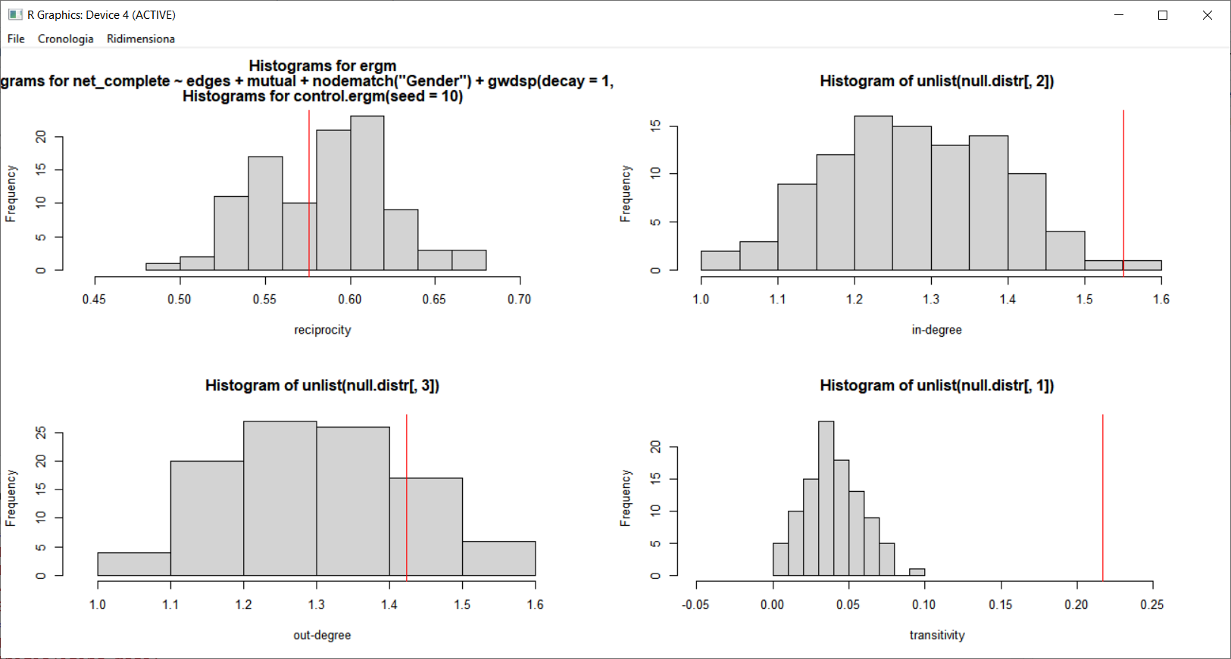

Model Diagnostics: Social Circuit Model - Graph Complete
Notes:
F: modello edges+mutual+nodematch predicev ameglio sull'indegree, ma non coglieva comunque la transitività

Slide 22
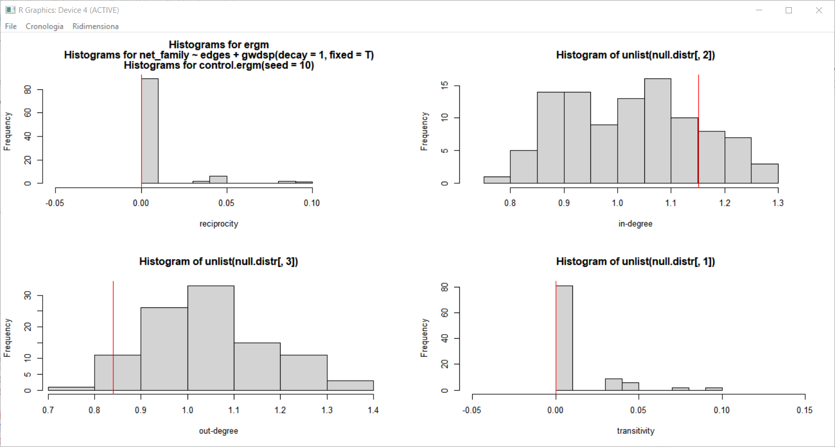

Model Diagnostics: Social Circuit Model - Graph Family
Notes:
P

Slide 23
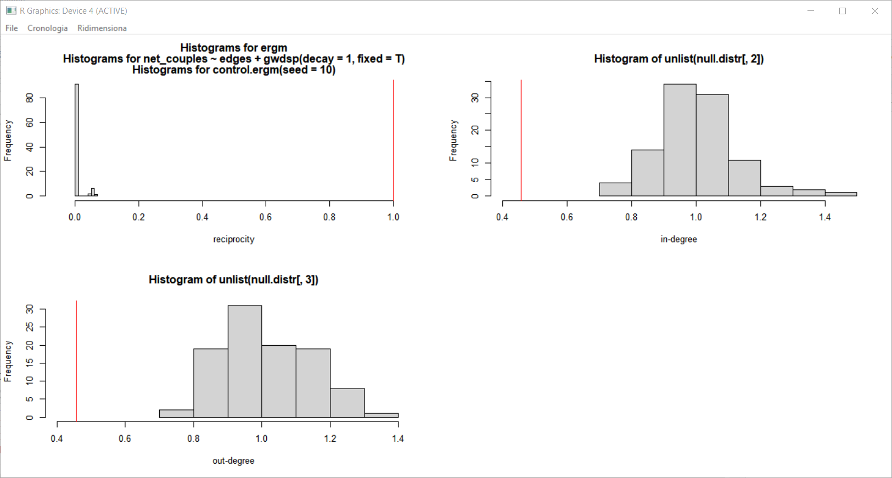

Model Diagnostics: Social Circuit Model - Graph Couples
Notes:
G

Slide 24
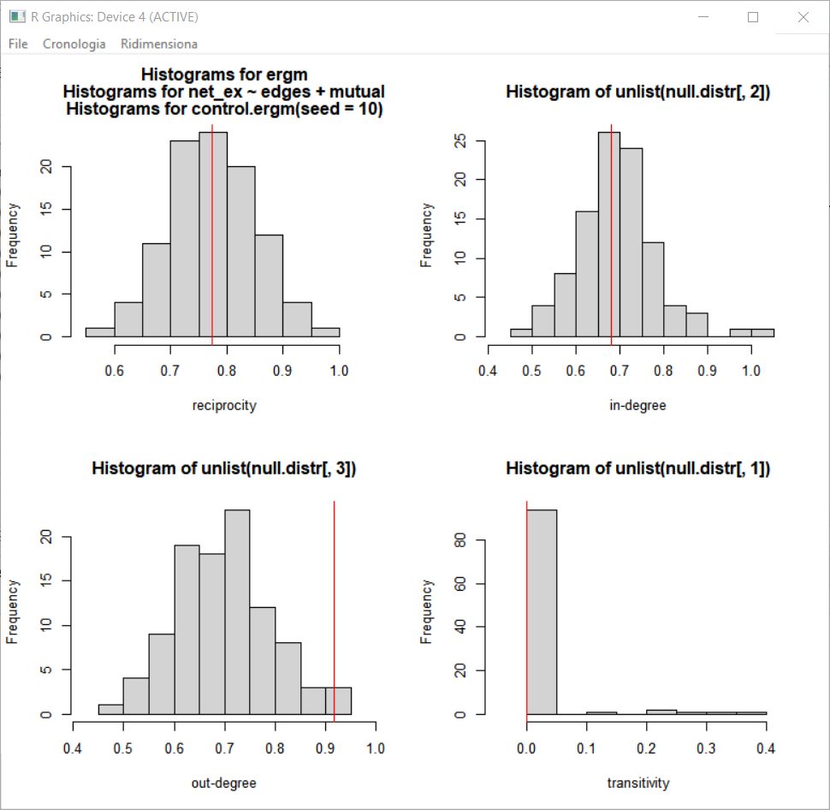
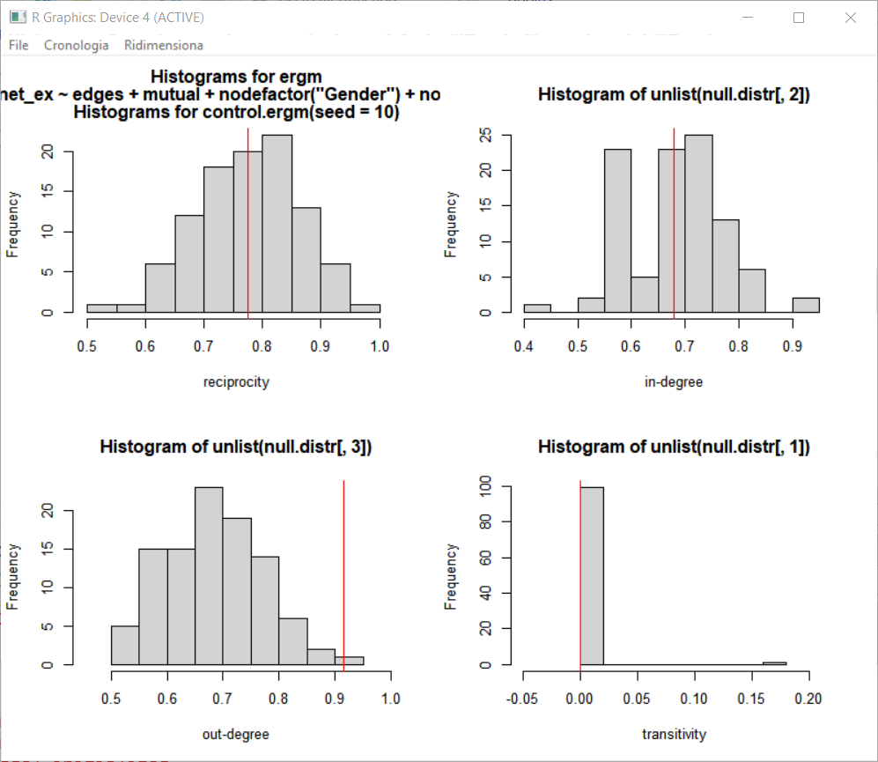

Model Diagnostics: p1 and nodal attributes Model- Exes Graph
mod3
mod4
Notes:
M

Slide 25
Models summary
Models (seed = 10) | Description | Features
Model 0 | Null model BRG | edges
Model 1 | NH-BRG | (Model 0 + sender + receiver)
Model 2 (not in code because it doesn't run) | NH-BRG | (Model 1 + mutual)
Model 3 (doesn't work only with couples) | NH-BRG | (Model 0 + mutual)
Model 4 | NH-BRG with nodal attributes (main + homophily effect) | (Model 3 + node_factor + node_match)
Model 5 | NH-BRG with nodal attributes (only homophily effect) | (Model 4 - node_factor)
Model 6 (not in code, degeneracy) | Markov Graph Model | (Model 5 + triangle term, in and out stars of order two)
Model 7 (not in code because it doesn't run) | Social Circuit Model with alternating k-triangle and alternating k-2-path | (Model 3 + node_match + gwdsp + gwesp)
Model 8 | Social Circuit Model with alternating k-2-path | (Model 3 + node_match + gwdsp)
Notes:
F

Slide 26

Block Models
Notes:
F

Slide 27
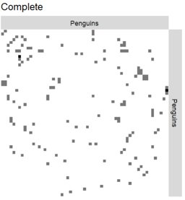
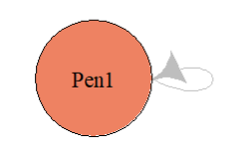

All the representations of the different adjacency matrices show a sparse situation
SBM Matrix Representation
For all models, according to ICL and loglikelihood, we obtained a single cluster in the both cases of Bernoulli and Poisson:
sbm_complete = estimateSimpleSBM(matrix_complete, "bernoulli", dimLabels = 'Penguins', estimOptions = list(verbosity = 1))
plot(sbm_complete, type = "data")
Notes:
F: ICL tiene conto sia della log-verosimiglianza sia del numero di parametri del modello, si seleziona il modello con ICL. e loglikelihood più alti

Slide 28
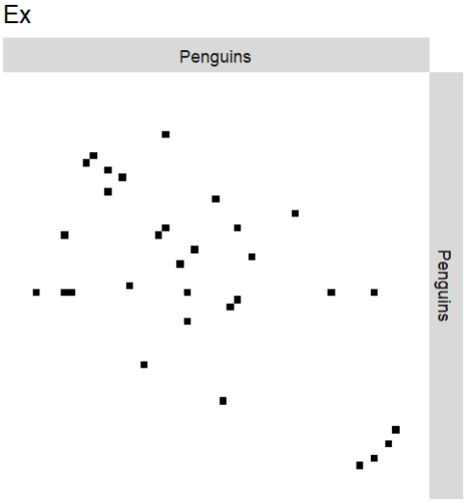
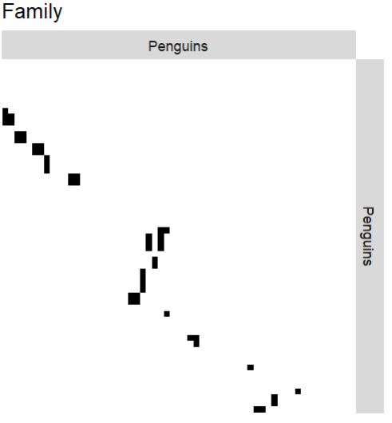
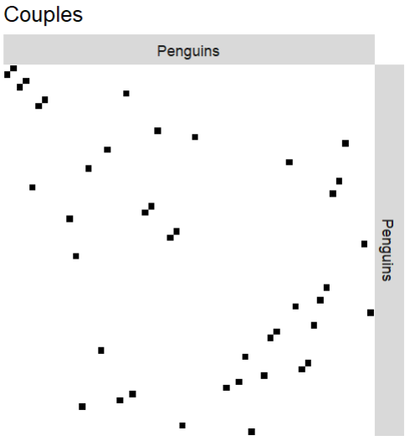


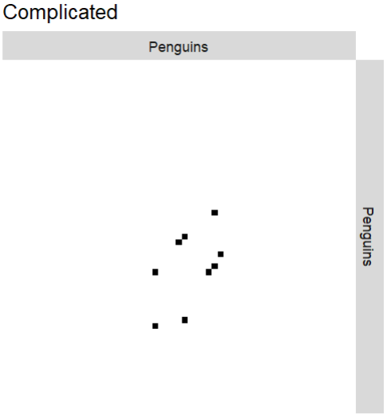
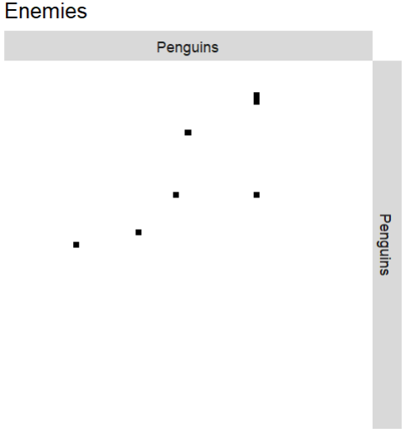
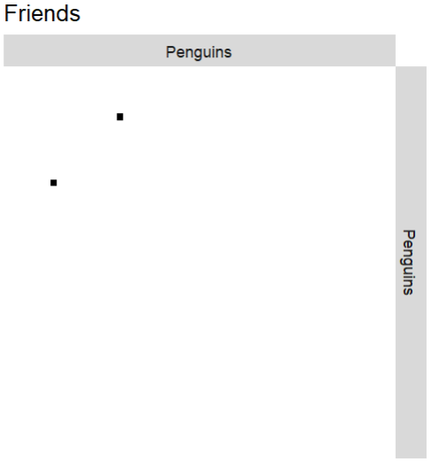
Notes:
F: couples e friends sono biderezionali

Slide 29
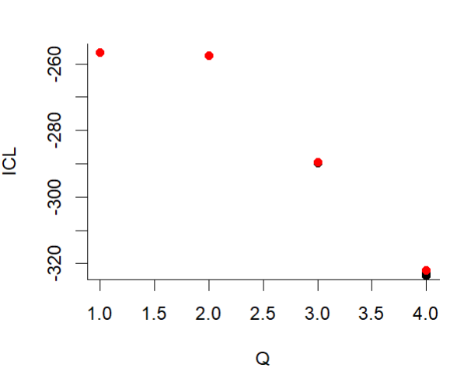
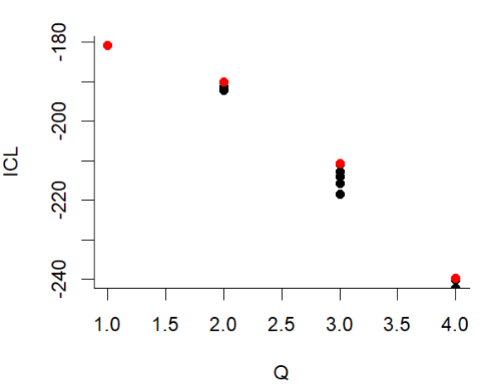

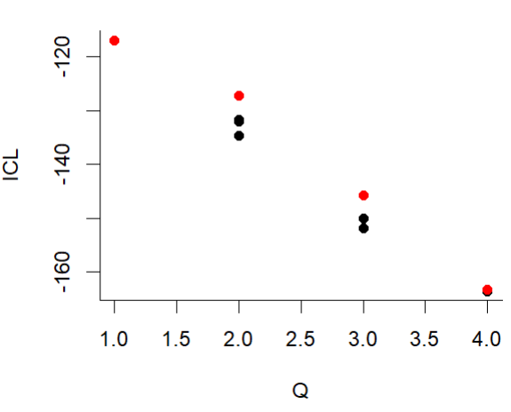
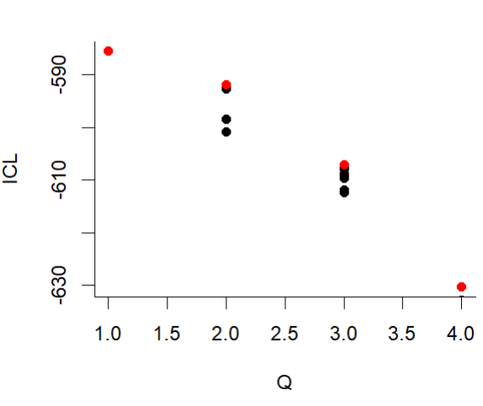
Family
Ex
Couples
Complete
Notes:
M (Rivedersi l'ICL)

Slide 30

Considerations
We selected other models with worst ICL and log-likelihood but with more than one cluster.
An attempt has been made to make a trade off between the number of clusters and the values of the metrics.
In the Couples Graph we observed that
there was always only one cluster
 | Family |  | Ex |  |  | Complete
Cluster id | 1 | 2 | 1 | 2 | 3 | 1 | 2
n_obs | 39 | 20 | 4 | 6 | 49 | 6 | 53
Notes:
M

Slide 31
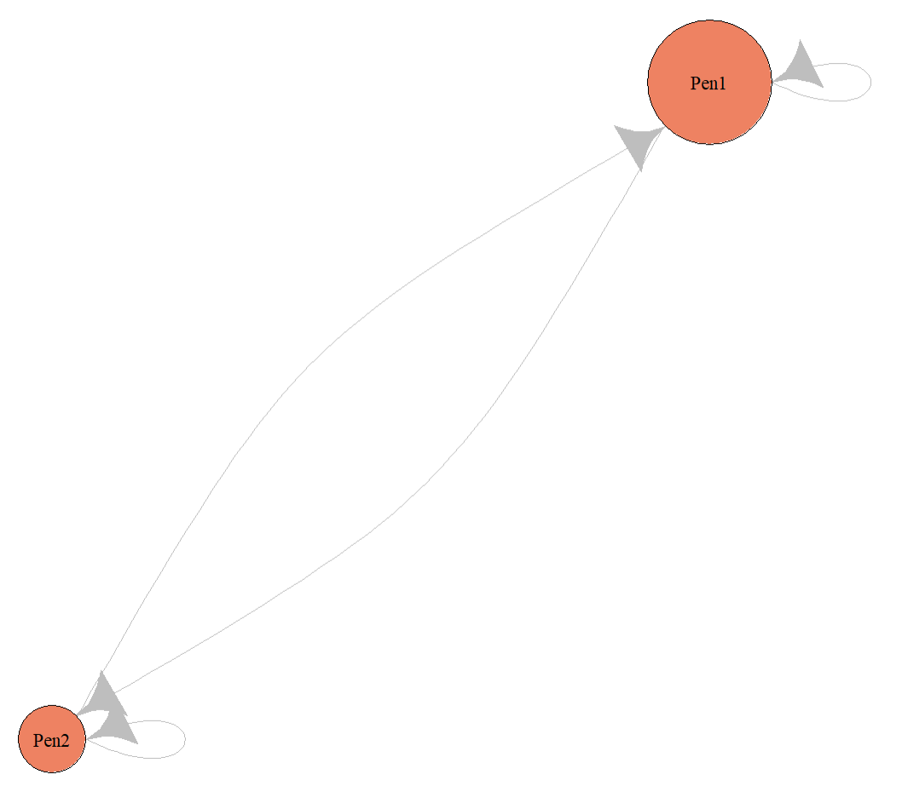
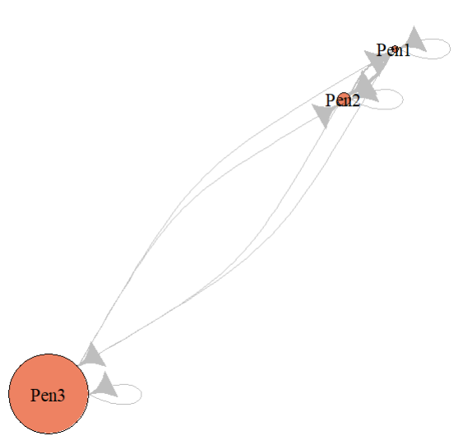
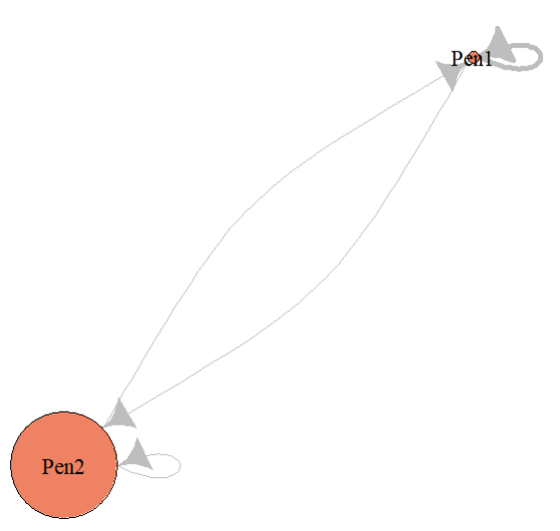


Family
Ex
Complete
Notes:
M

Slide 32
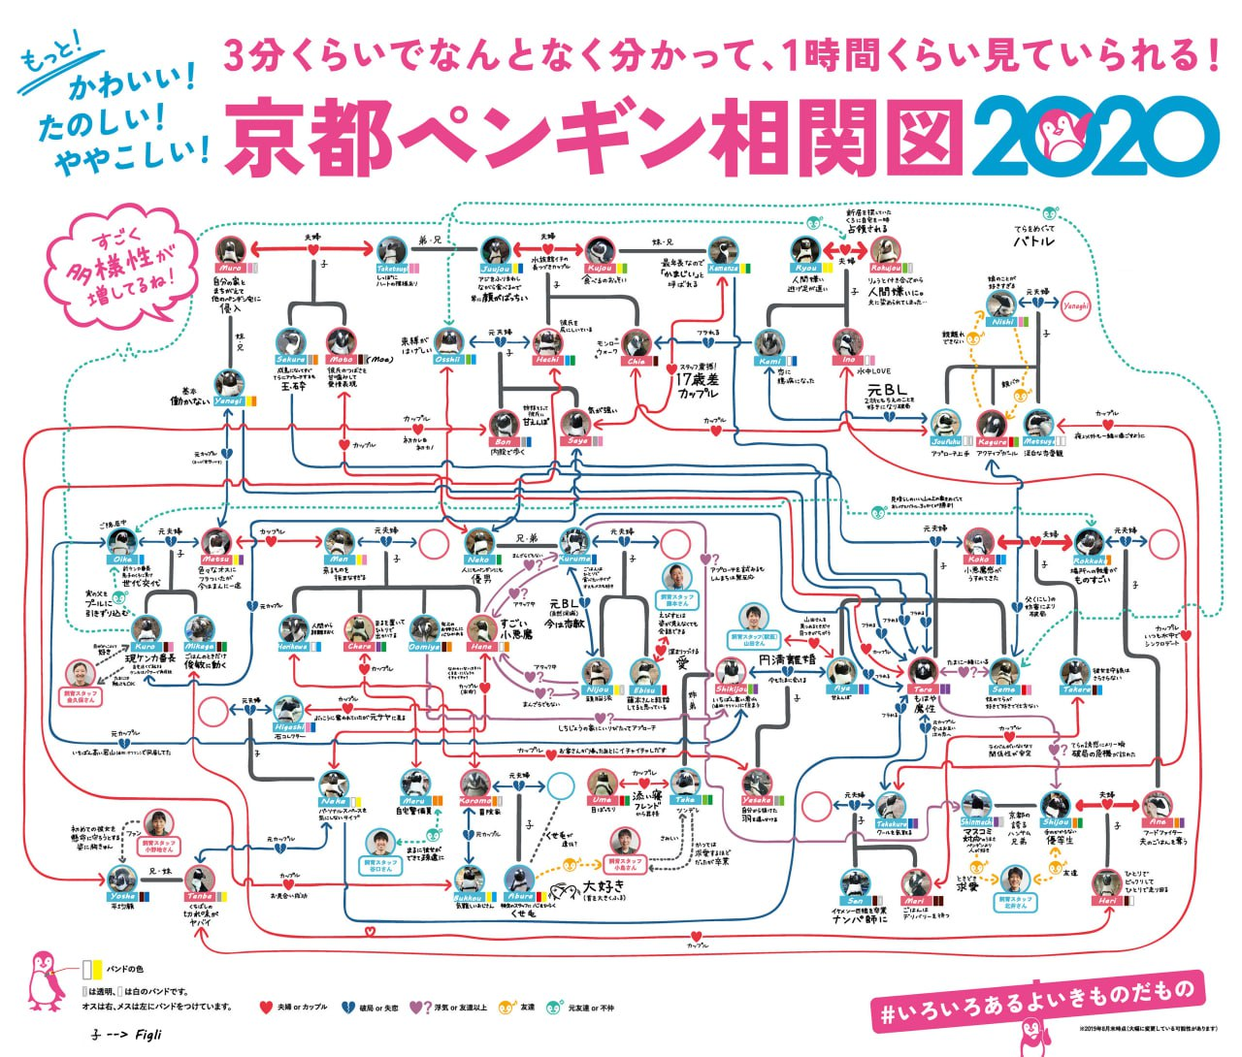
Notes:
P

Slide 33
Conclusions
The best model, according to AIC and BIC, is the social circuit with edges and alternating k-2 path both for Complete, Family and Couples graphs, but from the diagnostics these seems not so appropriate.
For the Exes graph we selected both P1 and nodal attributes model and from diagnostics seem to work better.
Tera is the most central node both in terms of out-degree, betwenness and eigenvector centrality in Exes and Complete graphs.
Koko has the highest in-degree and eigenvector centrality in Family graph and the maximum value of out-degree in the Complete graph
It can be seen, from the metadata, the most active and "devilish" penguins are those with more relationships, as it is reasonable.
Notes:
P

Slide 34
Notes:
P

Slide 35





Thanks for the attention
注目してくれてありがとう
注目してくれてありがとう
Thanks for the attention

